Slide 1
Mobile Medicare Clinics- Fall 2015
UNIVERSITY OF THE PACIFIC
THOMAS J. LONG SCHOOL OF PHARMACY AND HEALTH SCIENCES

Slide 2
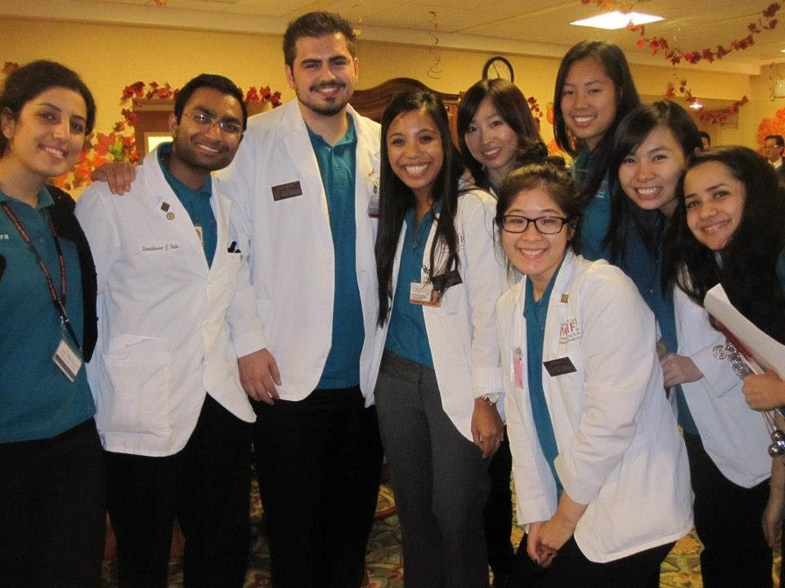
Who we are and why we are here?
• University of the Pacific student pharmacists
• Medicare Part D elective course
Community Outreach Efforts

Slide 3
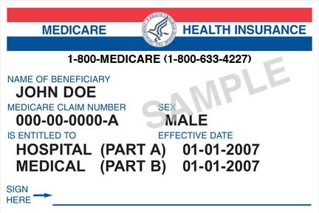
What is Medicare?
Medicare is a complex federal health insurance that covers nearly 55 million Americans
Seniors (age 65 and older)
Permanently Disabled
End-Stage Renal Disease (ESRD)
Amyotrophic Lateral Sclerosis (aka Lou Gehrig’s Disease)
Exposed to Environmental Health Hazards

Slide 4

Parts of Medicare
Four different parts of Medicare:
Part A = Hospital
Part B = Medical
Part C = A + B +/- D
Part D = Outpatient Prescription Drugs

Slide 5
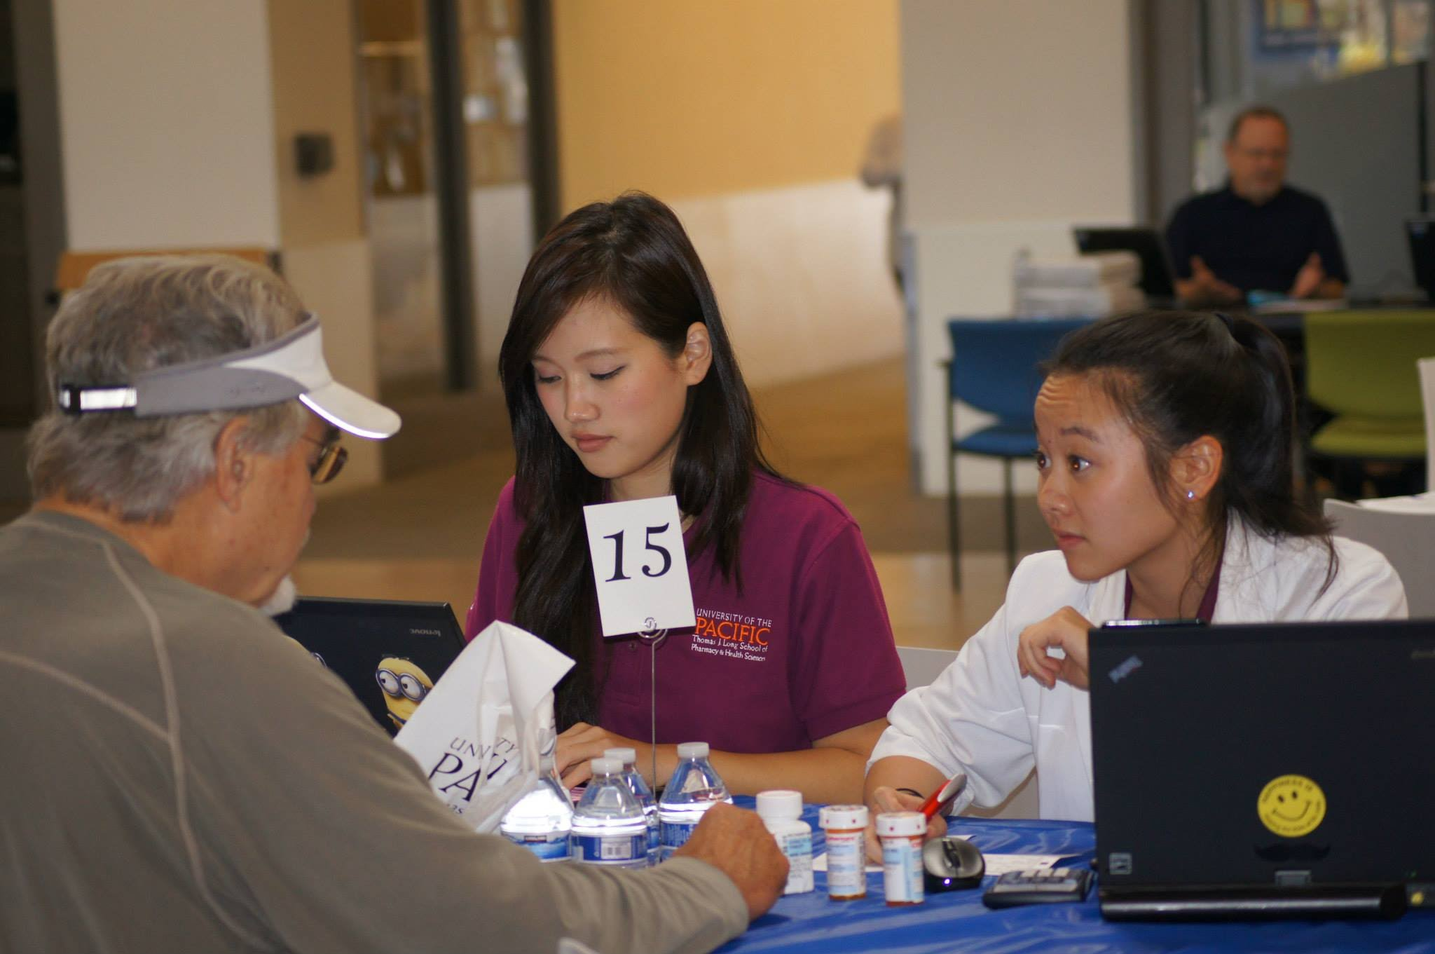
Medicare Part D
Many parameters (plan formularies and cost-sharing structure) of Part D plans change each year, and this is where we come into play!

Slide 6
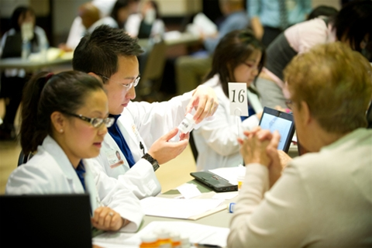
How we help patients- Part D
1. Potentially save them $$$ on their prescription medication costs
- Up to 9/10 can potentially save $
- On average, ~$900/person annually
2. Evaluate all of their medications
- For safety, effectiveness and to increase patient engagement and understanding

Slide 7
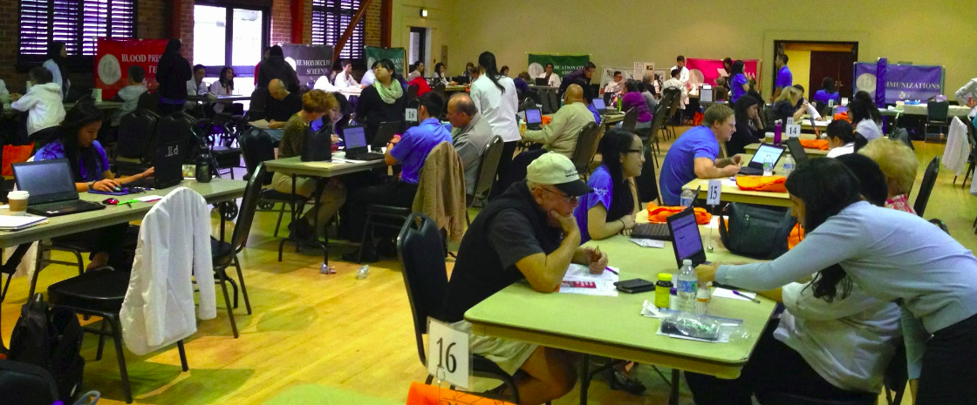
Medication Therapy Management (MTM) Services
Comprehensive Medication Reviews
Drug-Drug Interactions
Therapeutic duplication
Side effects
Adherence
And so much more…
Prescriber follow-up
Personalized Medication Record
Education
Notes:
Elaborate on its positive impact

Slide 8
How we help patients- Disease State Screenings/Testing
Anemia Screening
Asthma and COPD testing
Anxiety Screening
Blood Pressure
Bone Density testing
Cholesterol Testing
Depression Screening
Diabetes Testing
Falls Risk Assessment
Insomnia Screening
Memory Decline Screening
Vaccine Administration (flu, pneumococcal, and Tdap)

Slide 9
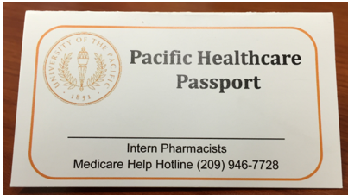
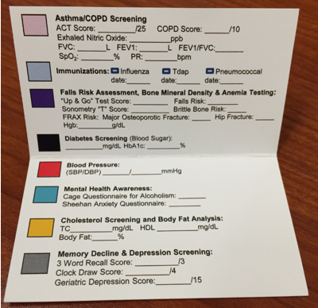
Pacific Healthcare Passport

Slide 10
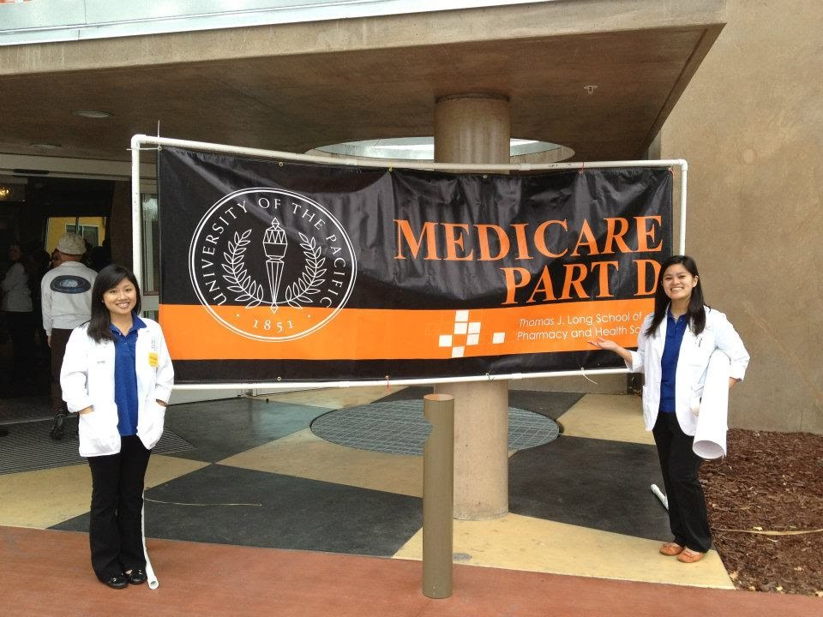
Our Medicare Part D Program Accomplishments
Since 2007:
89 outreach events in 16 different cities in California
Assisted 3,665 beneficiaries
Served 1,117 (30.5%) low-income beneficiaries
Helped 877 (23.9%) in their native languages
Medicare pharmacy students donated 12,591.5 hours of their time
Total savings on Part D drug costs to date= $3,283,193
Notes:
89 outreach events in 18 different cities in California
Assisted 3,665 beneficiaries with their Part D plan
Served 1,117 (30.5%) low-income beneficiaries
(e.g., Medi-Cal or Low-Income Subsidy Recipients)
Helped 877 (23.9%) beneficiaries in their native languages
Medicare trained pharmacy students have donated 12,591.5 hours of their time to help beneficiaries better understand their Part D plan and medications

Slide 11
See Us in Action!
Medicare Outreach Event Video

Slide 12
So, how can you become involved?
Shadow student pharmacists working under pharmacist supervision
Serve as Interpreters/Translators
Mandarin Cantonese Spanish
Russian Vietnamese American Sign Language
Spread the word about our events in your local community!
Flyers and brochures available
Notes:
Learn about Medicare Part D, Medication Therapy Management, health care screening services

Slide 13
What you can expect if you come…
You will:
have a learning activity so you can learn more about drugs and screenings we provide
sit side-by-side with us as we perform MTM/Medicare Part D interventions
be able to observe any health care screening/service station that you want
have the opportunity to talk to us about pharmacy school (in between interventions!)
have one-on-one time with a UOP faculty member

Slide 14
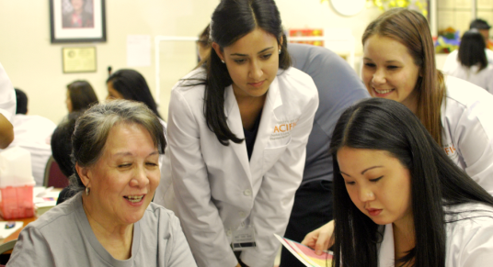
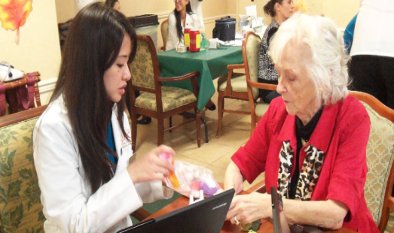
Mobile Medicare Clinics- Fall 2015
Stockton
Saturday, October 17th – School of Pharmacy(10pm-6pm)
Tuesday, October 20th – Northeast Community Center (1pm-6pm)
Saturday, November 7th – Merlo Gym (10am-5pm)
Friday, November 13th – First Congregational Church (1am-6pm)
Sunday, November 15th- O’Connor Woods (10am-6pm)
Lodi
Thursday, October 29th- LOEL Senior Center (1-6pm)
Tuesday, November 17th- Hutchins Street Square (1-7pm)
Tracy
Tuesday, October 27th- Tracy Community Center (1-6pm)
San Jose
Sunday, October 25th - Seven Trees CC (10am-5pm)
Oakland
Saturday, November 21st- Allen Temple Baptist Church (10am -5pm)
San Francisco
Sunday, November 8th - Jewish Community Center (10-5pm)
Berkeley
Saturday, October 18th – Ed Roberts Campus (10am-6pm)
Carmichael
Saturday, October 24th- Christ Community Church (10am-4pm)

Slide 15
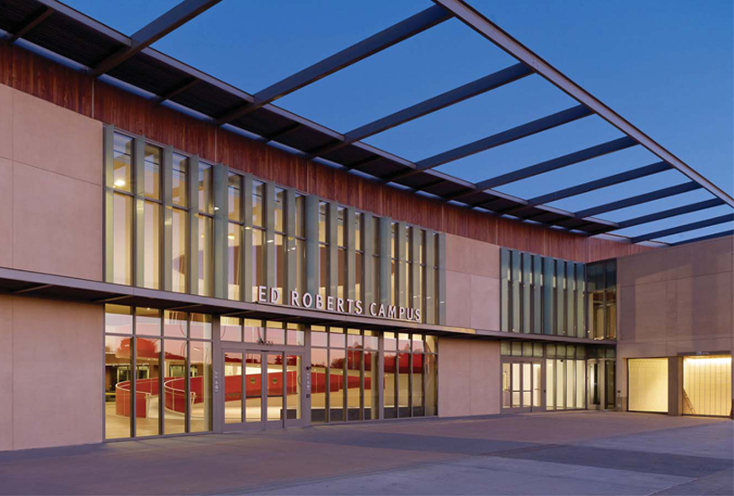
Berkeley Outreach Event
Ed Roberts Campus
3075 Adeline Street, Berkeley
Sunday, October 18th, 2015
10:00am to 6:00pm
Notes:
NOTE: NEED TO CHANGE FOR EVERY SINGLE EVENT
We are encouraging all those who would like to participate to sign up!
Depending on interest, students may have time slots shifts which will be organized
If in the middle of an intervention, please don’t leave! (Respect to those we are serving)
Other events available – please indicate on the sign-in form, along with time slot that you prefer

Slide 16
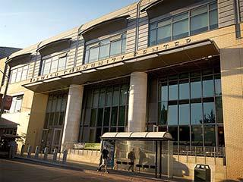
San Francisco Outreach Event
Jewish Community Center
3200 California Street, San Francisco
Sunday, November 8th, 2015
10:00am to 5:00pm
* Cantonese, Russian, Mandarin
speakers needed
Notes:
NOTE: NEED TO CHANGE FOR EVERY SINGLE EVENT
We are encouraging all those who would like to participate to sign up!
Depending on interest, students may have time slots shifts which will be organized
If in the middle of an intervention, please don’t leave! (Respect to those we are serving)
Other events available – please indicate on the sign-in form, along with time slot that you prefer

Slide 17
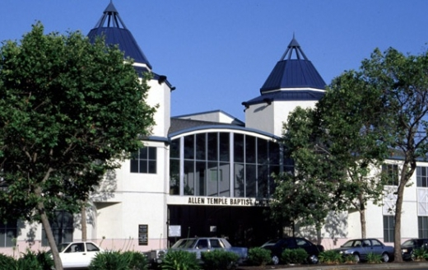
Oakland Outreach Event
Allen Temple Baptist Church
8501 International Boulevard, Oakland
Saturday, November 21st, 2015
10:00am to 5:00pm
Notes:
NOTE: NEED TO CHANGE FOR EVERY SINGLE EVENT
We are encouraging all those who would like to participate to sign up!
Depending on interest, students may have time slots shifts which will be organized
If in the middle of an intervention, please don’t leave! (Respect to those we are serving)
Other events available – please indicate on the sign-in form, along with time slot that you prefer

Slide 18
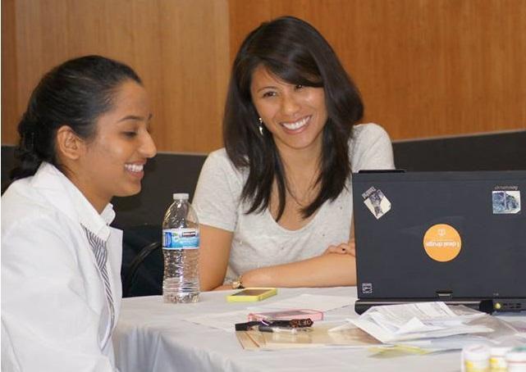
We would love to have you participate at our Mobile Medicare Clinics!
Please sign up using our Google form:
https://docs.google.com/forms/d/19siY2MYohBZvU0z8WW9hopI6BkPYTnaDTh15Enz7M1E/
We will need to know the following:
Full name, E-mail address, Phone #
University/School you are currently attending indicating graduation year
Event(s)/shifts you are interested in attending
Deadline to sign up: 3 days from today
Once notified that you have been chosen to participate, you will need to complete the following:
HIPAA Training
Volunteer Form and Student Conduct Contract
Flu vaccination

Slide 19
Contact Information
Max Araim
m_araim@u.pacific.edu
Connie Chong
c_chong1@u.pacific.edu
Lauren Clark
l_clark8@u.pacific.edu
Elena Lenkova
e_lenkova@u.pacific.edu
Susan Nguyen
s_nguyen24@u.pacific.edu
Dilraj Sohal
d_sohal@u.pacific.edu
Karen Zhao
k_zhao1@u.pacific.edu
Kiara Velazquez
k_velazquez@u.pacific.edu

